Slide 1
SoK: Limitations of Confidential Computing via TEEs for High-Performance Compute Systems
Ayaz Akram (yazakram@ucdavis.edu),
Venkatesh Akella, Sean Peisert, Jason Lowe-Power

Slide 2
Summary
We analyze existing trusted execution environments (TEEs)
to categorize them based on their characteristics
to find out the underlying principles current TEEs rely on
to find out if the existing TEEs are a good fit for HPC style systems
Current TEEs are not a good fit for HPC
large application modifications or large TCB
focus on core-level execution
inconsideration of side channels
We present a few research directions to build HPC-focused TEEs

Slide 3
Outline
What is confidential computing and secure HPC?
Requirements of an HPC-centric trusted execution environment?
Do existing TEEs work for HPC?
Way forward?

Slide 4
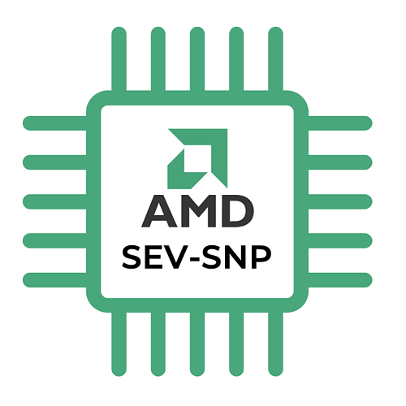
What is Confidential Computing?
Trusted Execution Environment
Confidential computing enables protection of "data in use"
mainly enabled by trusted execution environments (TEE)
TEEs provide
hardware-enforced isolation
cryptographic attestation to verify execution
no significant usability challenges
Secure
App.
Other
Apps.
OS
C
C
data in use
Physical memory
Zone of trust
Examples of TEEs
KeyStone

Slide 5
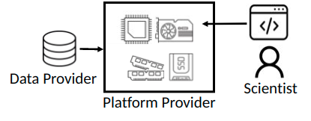
What is Secure HPC?
Lots of sensitive data
Health data Personally identifiable information Proprietary data
Want to give easy access to scientists
Need high performance compute without trusting platform provider¹
¹ Sean Peisert, "Security in high-performance computing environments", CACM, 2017.

Slide 6
Simplified threat model
Trusted Execution Environments
Physical memory
Zone of trust
Data
Open
Encrypted
Unsecured
provider
data
data
data
Runtime
Operating system
Untrusted
or OS
or hypervisor
Trusted
Data
Other
Secure
Normal
Normal
scientist
users
app
app
app
Untrusted
Compute provider
TEE

Slide 7
Outline
What is confidential computing and secure HPC?
Requirements of an HPC-centric trusted execution environment?
Limitations of existing TEEs for HPC?
Way forward?

Slide 8
What are the requirements of an HPC focused TEE?

Slide 9
Requirements for an HPC-centric TEE
Minimal performance penalties for HPC-style workloads
heavily multi-threaded and large working sets
Not require app. modifications or linking against special libs
Not require OS to be a part of the TCB
Capable of expanding across multiple compute nodes and other processing elements

Slide 10
Outline
What is confidential computing and secure HPC?
Requirements of an HPC-centric trusted execution environment?
Do existing TEEs work for HPC?
Way forward?

Slide 11
Do existing TEE technologies fit HPC environments?

Slide 12
We need to look at the TEE primitives of today to see if the HPC TEE requirements are fulfilled!

Slide 13
Primitives used by TEEs
Page table entry metadata
Examples include Intel SGX, AMD SEV
Encryption of physical memory
Examples include Graviton, AMD SEV, ARM RME
Physical memory isolation via ISA extensions
Examples include RISC-V PMP used by Keystone, TIMBER-V
New privileged layers
Can be hardware /software (e.g., ARM RME, CURE)
Use of tags and identifiers
Examples include ARM TrustZone, SiFive WorldGuard

Slide 14
These primitives impose limitations on TEEs!

Slide 15
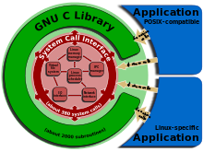
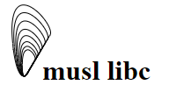
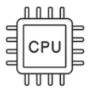
Limitations of current TEEs
Heavy application code modifications
limited support for traditional C libs
Large TCB
entire guest OS in enclave
Focus on core-level execution
Other limitations
fragmentation
scalability
data movement

Slide 16
Requirements for an HPC-centric TEE
Minimal performance penalties for HPC-style workloads
heavily multi-threaded and large working sets
Not require app. modifications or linking against special libs
Not require OS to be a part of the TCB
Capable of expanding across multiple compute nodes and other processing elements

Slide 17
Outline
What is confidential computing and secure HPC?
Requirements of an HPC-centric trusted execution environment?
Do existing TEEs work for HPC?
Way forward?

Slide 18
What is the way forward?

Slide 19
Simplified view of a modern HPC system
System view today
Local node Accelerator Remote node
App.
Th0 … ThN
App.
App.
App.
OS
OS
Core … Core
Acc.
Core
Memory
Mem.
Mem.
Current TEEs can help create silos for individual components

Slide 20
Our vision of a trusted modern HPC system
Trusted system view
Local node Accelerator Remote node
App.
App.
App.
Core
Acc.
Core
Memory

Slide 21
Our vision of a trusted modern HPC system
Trusted system view
Local node Accelerator Remote node
App.
App.
App.
No OS in TCB
Core
Acc.
Core
Memory
Inclusive trusted components view

Slide 22
Our vision of a trusted modern HPC system
Trusted system view
Local node Accelerator Remote node
App.
App.
App.
Core
Acc.
Core
Memory

Slide 23
Our vision of a trusted modern HPC system
Trusted system view
Local node Accelerator Remote node
App.
App.
App.
Core
Acc.
Core
Memory
This is what we want!
1) for security
And, also
2) for performance

Slide 24
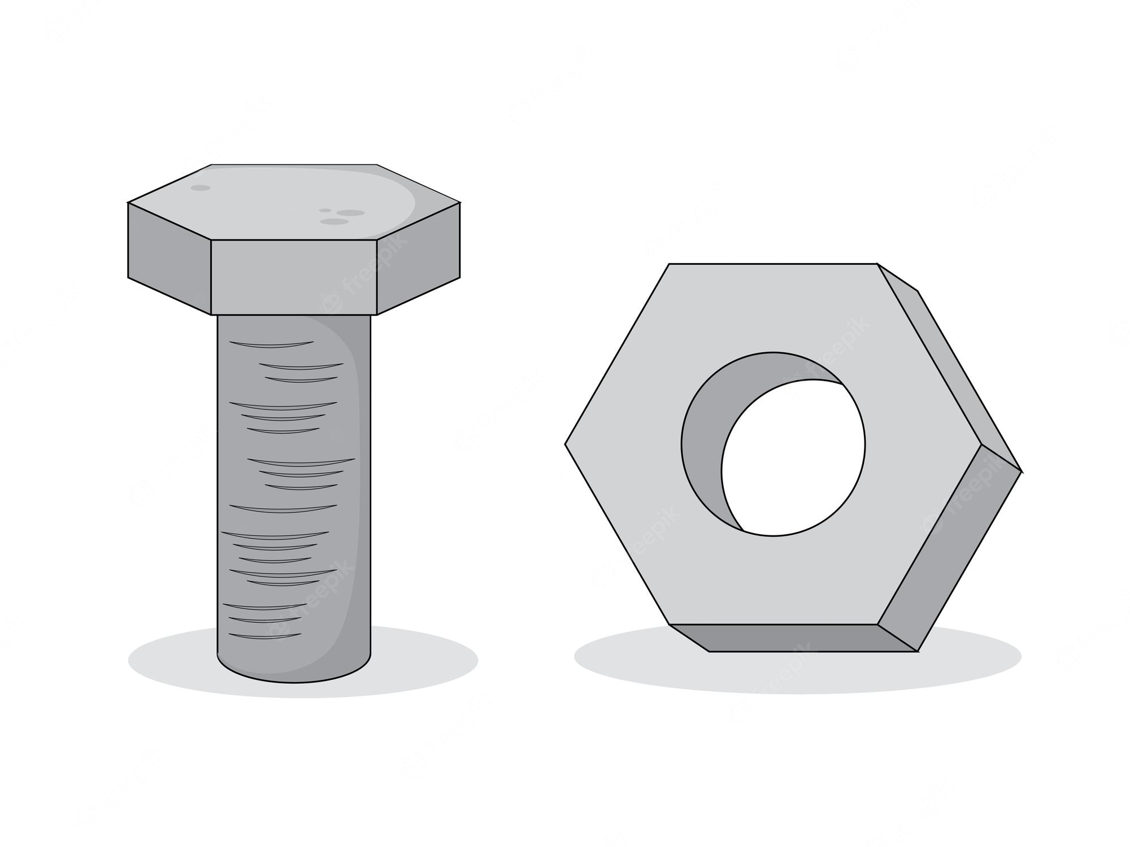
Promising research directions
New hardware primitives
Horizontal privilege levels
Data centric enclaves
Capability based enclaves

Slide 25
Summary
We analyze existing trusted execution environments (TEEs)
to categorize them based on their characteristics
to find out the underlying principles current TEEs rely on
to find out if the existing TEEs are a good fit for HPC style systems
Current TEEs are not a good fit for HPC
large application modifications or large TCB
focus on core-level execution
inconsideration of side channels
We present a few research directions to build HPC-focused TEEs

Slide 26
Acknowledgment
We acknowledge the support of the following entities
Director, Office of Science, Office of Advanced Scientific Computing Research, of the U.S. DOE under Contract No. DE-AC02-05CH11231.
National Science Foundation under Grant No. CNS1925724.
Anonymous reviewers for their valuable feedback.

Slide 27
Thanks for listening!
Questions?

Slide 28
SoK: Limitations of Confidential Computing via TEEs for High-Performance Compute Systems
Ayaz Akram (yazakram@ucdavis.edu),
Venkatesh Akella, Sean Peisert, Jason Lowe-Power

