Slide 1
Supporting x86-64 Address Translation for 100s of GPU Lanes
Jason Power, Mark D. Hill, David A. Wood

Slide 2
Summary
CPUs & GPUs: physically integrated, logically separate
  Near Future: Cache coherence, Shared virtual address space
Proof-of-concept GPU MMU design
  Per-CU TLBs, highly-threaded PTW, page walk cache
  Full x86-64 support
  Modest performance decrease (2% vs. ideal MMU)
Design alternatives not chosen
Notes:
Say memory management unit

Slide 3
Motivation
Closer physical integration of GPGPUs
Programming model still decoupled
  Separate address spaces
  Unified virtual address (NVIDIA) simplifies code
  Want: Shared virtual address space (HSA hUMA)

Slide 4
Tree Index
Hash-table Index
CPU address space
Notes:
Tree index: something like barnes-hut

Slide 5
Separate Address Space
CPU address space
Transform to new pointers
Transform to new pointers
Simply copy data
GPU address space

Slide 6
Unified Virtual Addressing
CPU address space
1-to-1 addresses
GPU address space

Slide 7
Unified Virtual Addressing
void main() {
int *h_in, *h_out;
h_in = cudaHostMalloc(sizeof(int)*1024); // allocate input array on host
h_in = ... // Initial host array
h_out = cudaHostMalloc(sizeof(int)*1024); // allocate output array on host
Kernel<<<1,1024>>>(h_in, h_out);
... h_out // continue host computation with result
cudaHostFree(h_in); // Free memory on host
cudaHostFree(h_out);
}

Slide 8
Shared Virtual Address Space
CPU address space
1-to-1 addresses
GPU address space

Slide 9
Shared Virtual Address Space
No caveats
Programs “just work”
Same as multicore model

Slide 10
Shared Virtual Address Space
Simplifies code
Enables rich pointer-based datastructures
  Trees, linked lists, etc.
Enables composablity
Need: MMU (memory management unit) for the GPU
Low overhead
Support for CPU page tables (x86-64)
4 KB pages
Page faults, TLB flushes, TLB shootdown, etc
Notes:
6:16

Slide 11
Outline
Motivation
Data-driven GPU MMU design
  D1: Post-coalescer MMU
  D2: +Highly-threaded page table walker
  D3: +Shared page walk cache
Alternative designs
Conclusions

Slide 12
System Overview

Slide 13
GPU Overview
Notes:
Say number of lanes
Explain coalescer

Slide 14
Methodology
Target System
  Heterogeneous CPU-GPU system
    16 CUs, 32 lanes each
  Linux OS 2.6.22.9
Simulation
  gem5-gpu – full system mode (gem5-gpu.cs.wisc.edu)
Ideal MMU
  Infinite caches
  Minimal latency

Slide 15
Workloads
Rodinia benchmarks
Database sort
  10 byte keys, 90 byte payload
  backprop
  bfs: Breadth-first search
  gaussian
  hotspot
  lud: LU-decomposition
  nn: nearest-neighbor
  nw: Needleman-Wunsch
  pathfinder
  srad: anisotropic diffusion

Slide 16
GPU MMU Design 0
Notes:
Say something about “too much state”

Slide 17
Design 1
Per-CU MMUs:
Reducing the translation request rate

Slide 18
Lane
Lane
Lane
Lane
Lane
Lane
Lane
Lane
Lane
Lane
Lane
Lane
Lane
Lane
Lane
Lane
Notes:
Somehow say 1 compute unit

Slide 19
Lane
Lane
Lane
Lane
Lane
Lane
Lane
Lane
Lane
Lane
Lane
Lane
Lane
Lane
Lane
Lane
1x
Shared Memory
(scratchpad)
0.45x

Slide 20
Lane
Lane
Lane
Lane
Lane
Lane
Lane
Lane
Lane
Lane
Lane
Lane
Lane
Lane
Lane
Lane
1x
Shared Memory
(scratchpad)
Coalescer
0.45x
0.06x

Slide 21
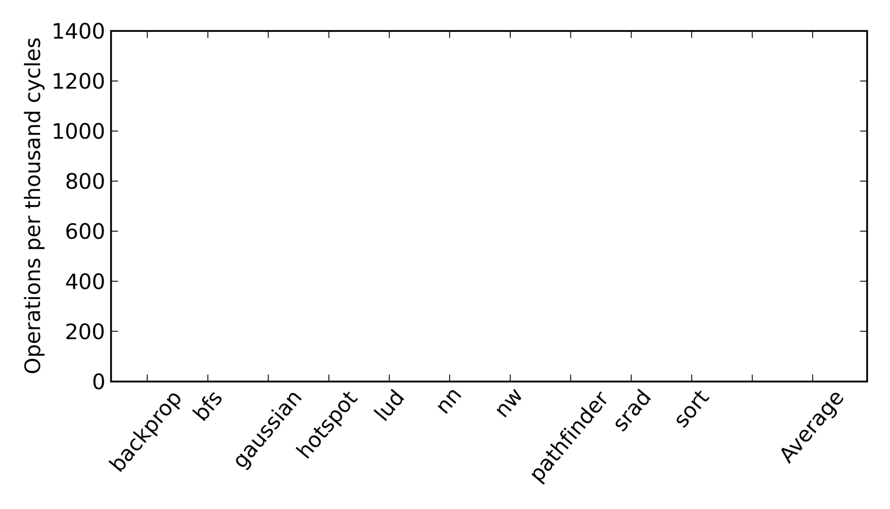
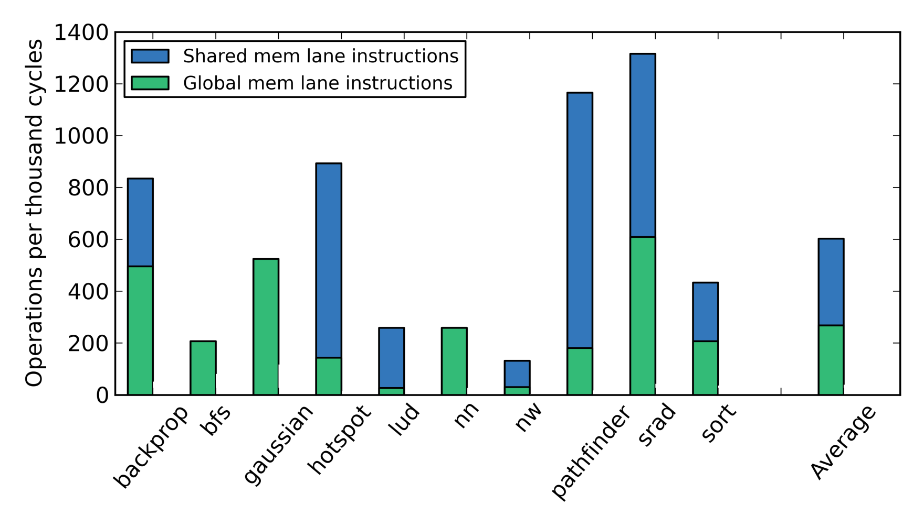
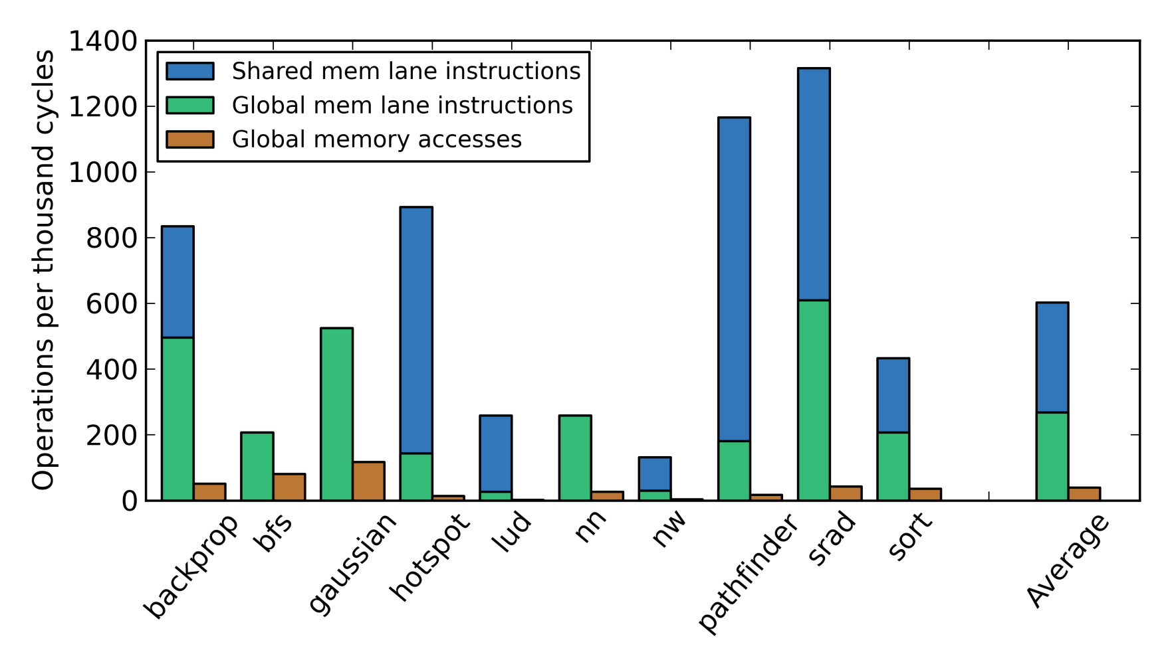
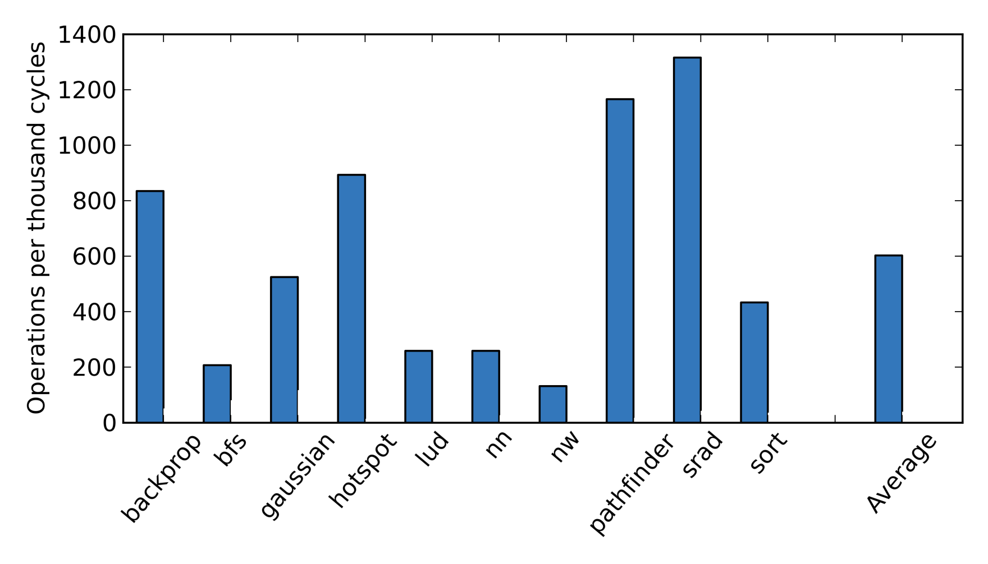
Reducing translation request rate
Breakdown of memory operations
Shared memory and coalescer effectively filter global memory accesses
Average 39 TLB accesses per 1000 cycles
Notes:
3 slides, one for each bar!!!!!!!!!!!!!!

Slide 22
Design 1

Slide 23
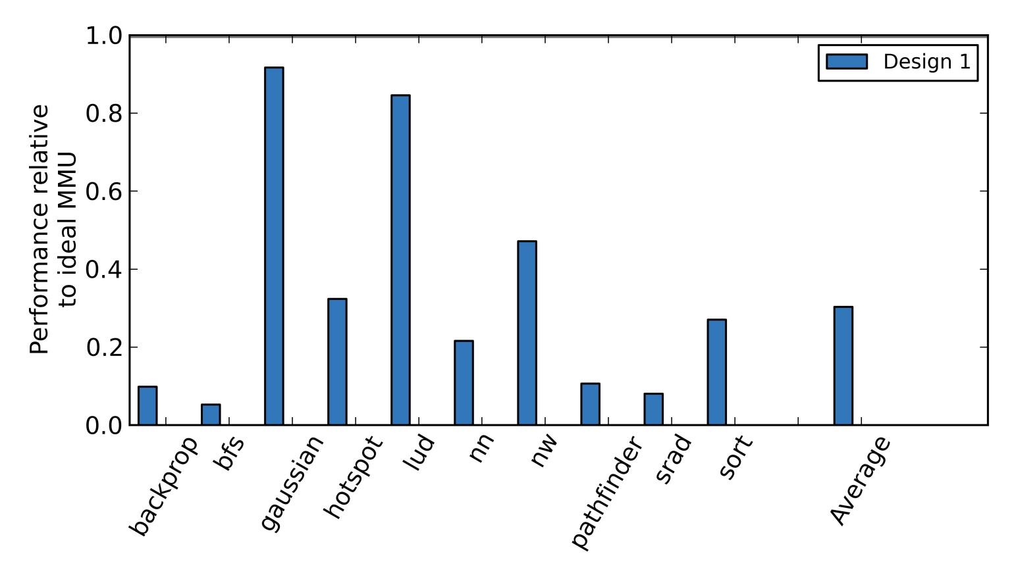
Performance

Slide 24
Design 2
Highly-threaded page table walker:
Increasing TLB miss bandwidth

Slide 25
Lane
Lane
Lane
Lane
Lane
Lane
Lane
Lane
Lane
Lane
Lane
Lane
Lane
Lane
Lane
Lane
Shared Memory
Coalescer
Outstanding TLB Misses

Slide 26
Lane
Lane
Lane
Lane
Lane
Lane
Lane
Lane
Lane
Lane
Lane
Lane
Lane
Lane
Lane
Lane
Shared Memory
Coalescer
Outstanding TLB Misses

Slide 27
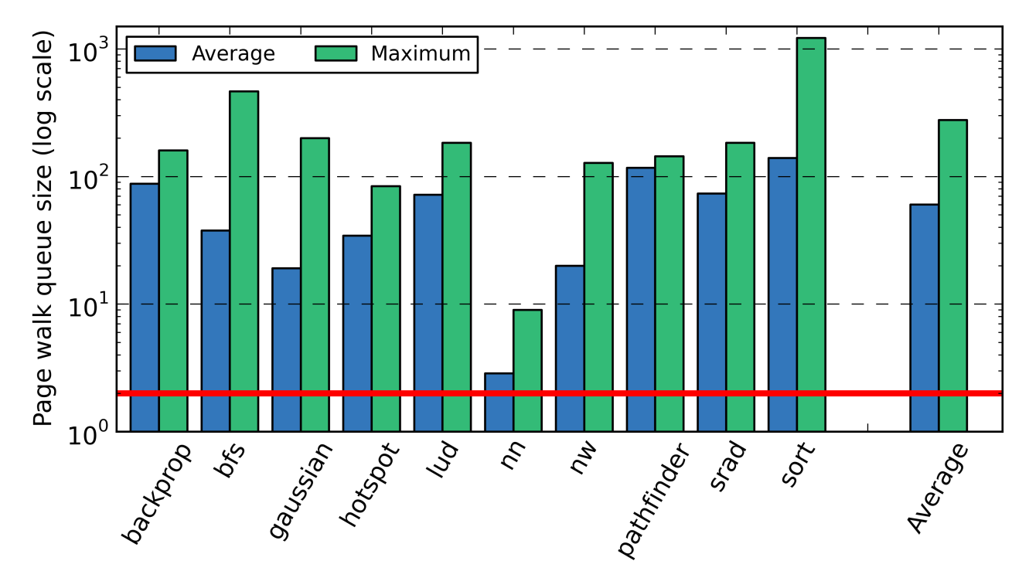
Multiple outstanding page walks
Concurrent page walks when non-zero (log scale)
2
Many workloads are bursty
Miss latency skyrockets due to queuing delays if blocking page walker

Slide 28
Design 2
Notes:
Add a slide about how that works?

Slide 29
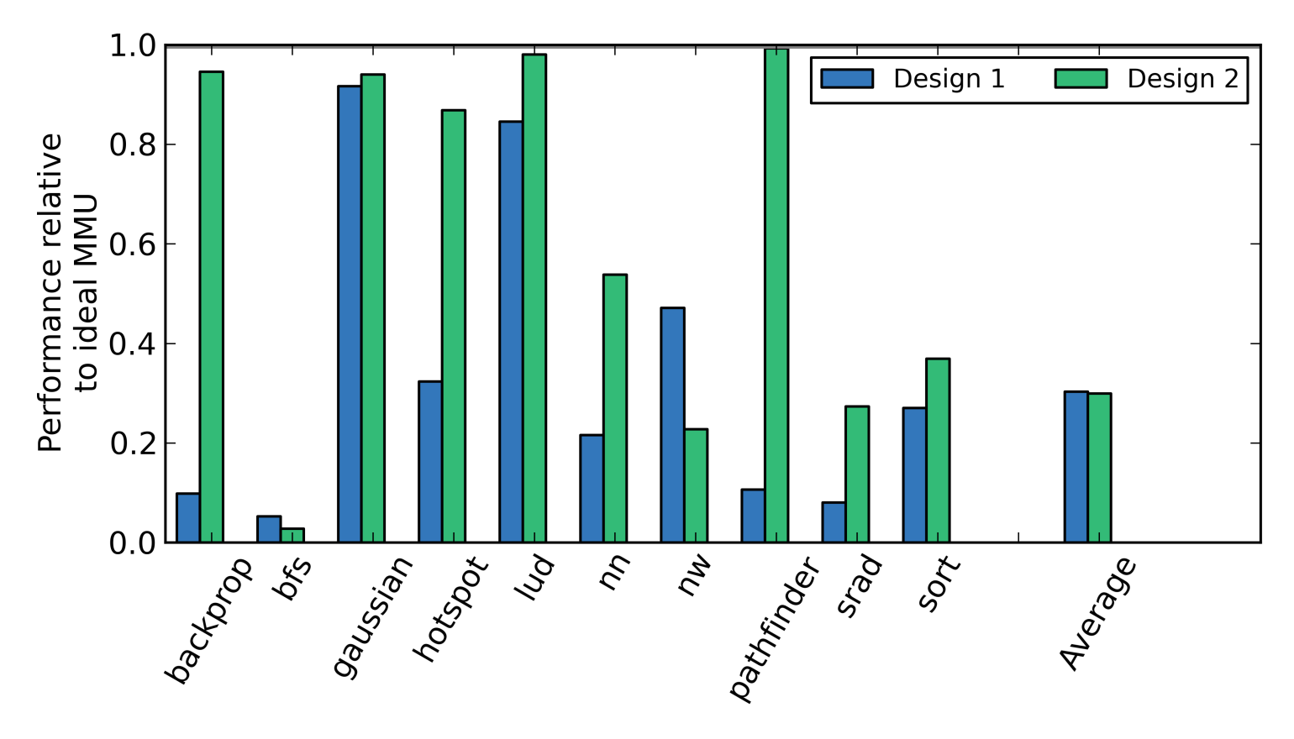
Performance

Slide 30
Design 3
Page walk cache:
Overcoming high TLB miss rate

Slide 31
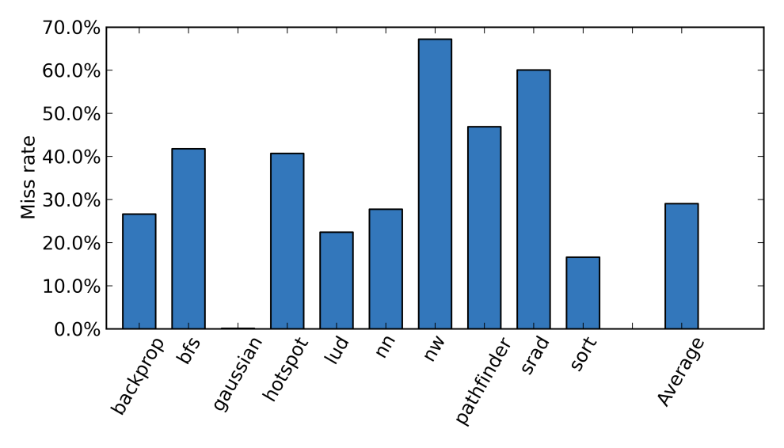
High L1 TLB miss rate
Per-access Rate with 128 entry L1 TLB
Average miss rate: 29%!
Notes:
Title for per reference add 128 entry

Slide 32
High TLB miss rate
Requests from coalescer spread out
  Multiple warps issuing unique streams
  Mostly 64 and 128 byte requests
Often streaming access patterns
  Each entry not reused many times
  Many demand misses

Slide 33
Design 3

Slide 34
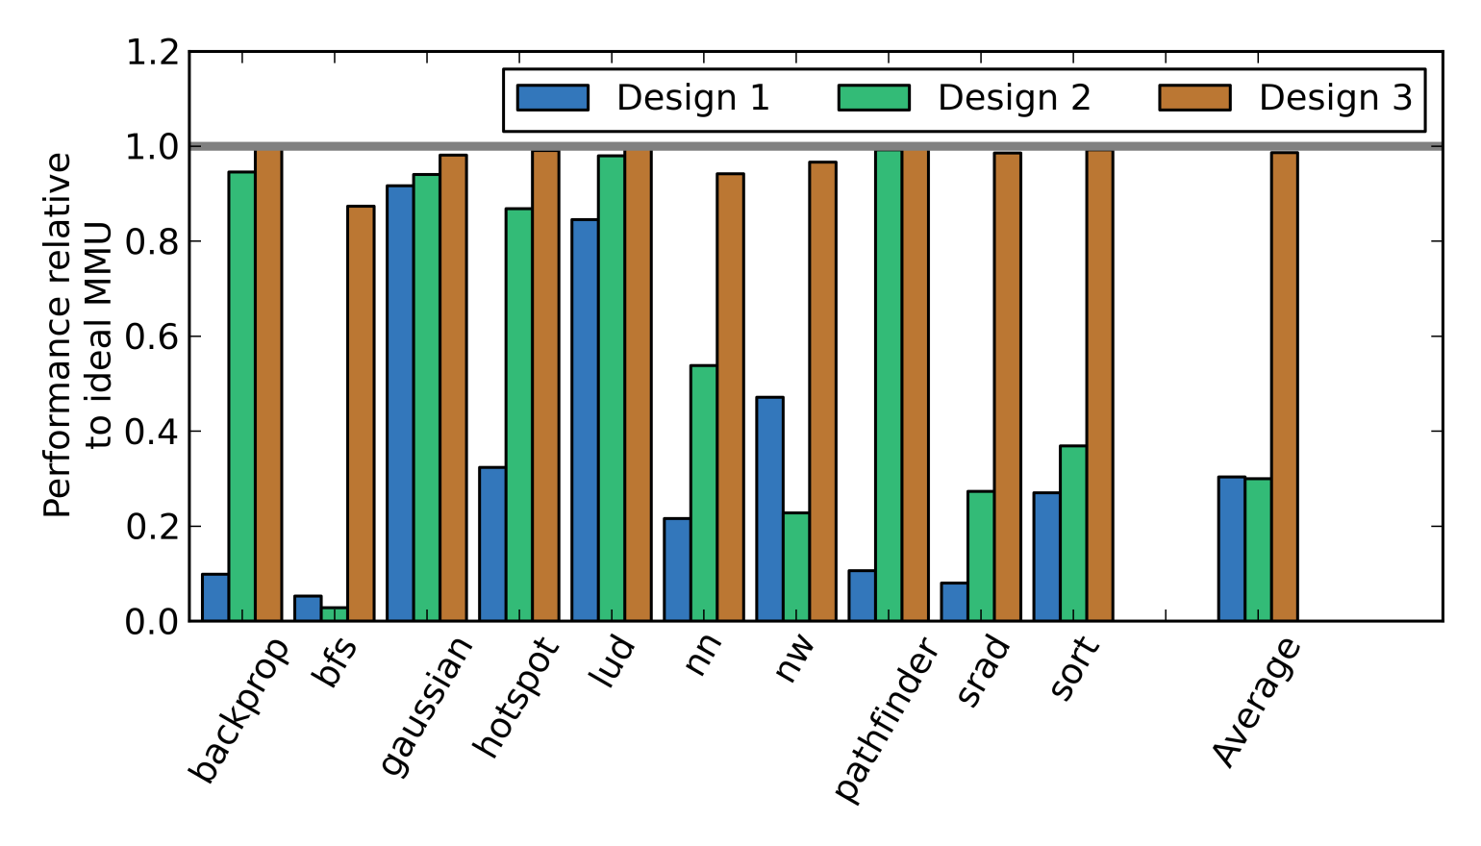
Performance
Average: Less than 2% slowdown
Worst case: 12% slowdown

Slide 35
Correctness Issues
Page faults
  Stall GPU as if TLB miss
  Raise interrupt on CPU core
  Allow OS to handle in normal way
  One change to CPU microcode, no OS changes
TLB flush and shootdown
  Leverage CPU core, again
  Flush GPU TLBs whenever CPU core TLB is flushed
Notes:
Define major/minor page faults

Slide 36
Page faults
 | Number of page faults | Average page fault latency
Lud | 1 | 1698 cycles
Pathfinder | 15 | 5449 cycles
Cell | 31 | 5228 cycles
Hotspot | 256 | 5277 cycles
Backprop | 256 | 5354 cycles
Minor Page faults handled correctly by Linux
5000 cycles = 3.5 µsec: too fast for GPU context switch

Slide 37

Summary
 | Per-CU L1 TLB entries | Highly-threaded page table walker | Page walk cache size | Shared L2 TLB entries
Ideal MMU | Infinite | Infinite | Infinite | None
Design 0 | N/A: Per-lane MMUs |  | None | None
Design 1 | 128 | Per-CU walkers | None | None
Design 2 | 128 | Yes (32-way) | None | None
Design 3 | 64 | Yes (32-way) | 8 KB | None
D3: proof of concept
Non-exotic design
Low overhead
Fully compatible
Correct execution

Slide 38
Outline
Motivation
Data-driven GPU MMU design
Alternative designs
  Shared L2 TLB
  TLB prefetcher
  Large pages
Conclusions
Notes:
18:38

Slide 39
Alternative Designs
Shared L2 TLB
  Shared between all CUs
  Captures address translation sharing
  Poor performance: increased TLB-miss penalty
Shared L2 TLB and PWC
  No performance difference
  Trade-offs in the design space

Slide 40
Alternative Designs
TLB prefetching:
  Simple 1-ahead prefetcher does not affect performance
Large pages:
  Effective at reducing TLB misses
  Requiring places burden on programmer
  Must have compatibility

Slide 41

Alternative Design Summary
 | Per-CU L1 TLB entries | Page walk cache size | Shared L2 TLB entries | Performance
Design 3 | 64 | 8 KB | None | 0%
Shared L2 | 64 | None | 1024 | 50%
Shared L2 & PWC | 32 | 8 KB | 512 | 0%
Each design has 16 KB extra SRAM for all 16 CUs
PWC needed for some workloads

Slide 42
Conclusions
Shared virtual memory is important
Non-exotic MMU design
  Post-coalescer L1 TLBs
  Highly-threaded page table walker
  Page walk cache
Full compatibility with minimal overhead
Notes:
23:48

Slide 43
Questions?

Slide 44
Related Work
Architectural Support for Address Translation on GPUs: Pichai, Hsu, Bhattacharjee
  Concurrent with our work
  High level: modest changes for high performance
  Pichai et al. investigate warp scheduling
  We use a highly-threaded PTW

Slide 45
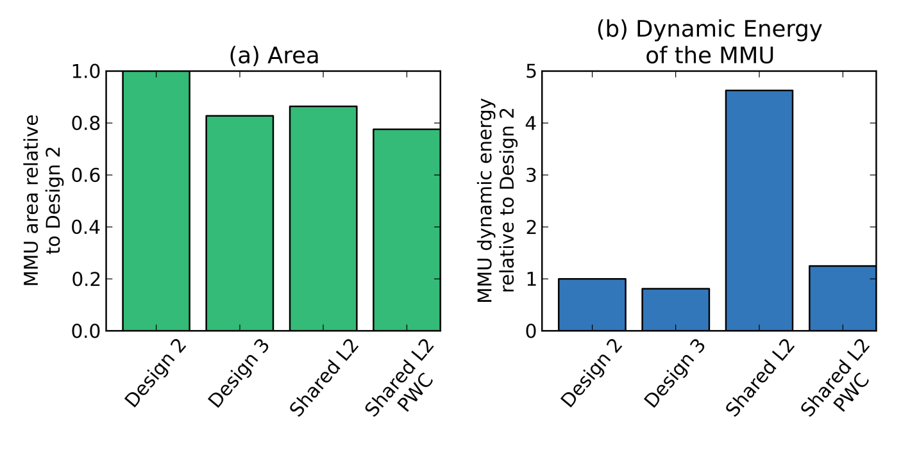
Energy and Area of Unified MMU
These configurations provide a huge performance improvement
over D2 AND reduce area and (maybe) energy
*data produced using McPAT and CACTI 6.5
Notes:
Methods. Put down cacti and McPAT

Slide 46
Highly-threaded PTW

Slide 47
Page-fault Overview

